Slide 1
Champion Annotator
Thomas Dil, Ben Kulbago, Tim McDaniel, Daniel Schnipke

Slide 2
Stages of setup
Manual data ingestion
Feature detection
Train neural net

Slide 3
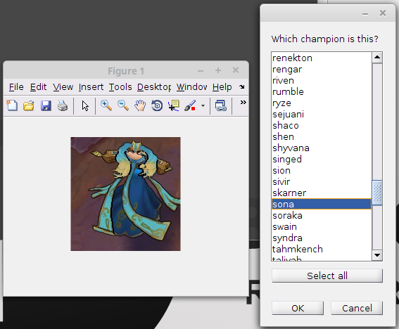
Manual Data Ingestion

Slide 4
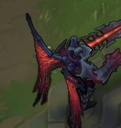

Feature Detection

Slide 5
Neural Net
1x(size of feature) 1x(number of champions)
7*7*3 136
Hidden Layer of 10 neurons

Slide 6
Usage
Load image or videos as series of images
Feature detect
Pass into neural net
Draw results on image
Output as desired

